Slide 1



EQUIPMENT BOOKING SYSTEM
23CDR033 Dhanushri M
23CDR043 Divya C S

Slide 2


PROBLEM STATEMENT
Organizations often face issues managing shared equipment like laptops or projectors due to lack of a centralized system, leading to conflicts and poor utilization. A web-based Equipment Booking System is needed to allow users to view, reserve, and manage equipment efficiently while preventing double bookings and maintaining proper records using Python and an RDBMS.

Slide 3

MODULES
1
User Authentication Module
2
Equipment Management Module
3
Booking Module
4
Dashboard Module
5
Admin Authentication Module

Slide 4








USER AUTHENTICATION
EQUIPMENT MANAGEMENT
Login and registration
Role-based access (User/Admin)
Session handling and security
Add, update, delete equipment (admin)
View available equipment (users)
Equipment status (Available, Booked)
BOOKING
DASHBOARD
View available time slots
Reserve equipment
Prevent double booking
Modify or cancel bookings
User Dashboard: Past bookings
Admin Dashboard: monitor all reservations, manage users

Slide 5


1
USER TABLE
id (Primary Key) - int
name - varchar
email (Unique) - varchar
phone - varchar (e.g., 'admin', 'user')
password - varchar
gender - enum

Slide 6
2
ADMIN TABLE
id INT NOT NULL AUTO_INCREMENT
adminID VARCHAR(255) NOT NULL UNIQUE
password VARCHAR(255) NOT NULL
name VARCHAR(255) NOT NULL
PRIMARY KEY (id)

Slide 7
3
BOOK TABLE
BookID INT NOT NULL AUTO_INCREMENT
UserID INT
EquipmentID INT
BookingDate DATE
PRIMARY KEY (BookID)
FOREIGN KEY (UserID) REFERENCES user(UserID)
FOREIGN KEY (EquipmentID) REFERENCES equipment(EquipmentID)

Slide 8
4
EQUIPMENT TABLE
equipment (id INT AUTO_INCREMENT PRIMARY KEY
name VARCHAR(100) NOT NULL
description TEXT NOT NULL
quantity INT NOT NULL
category VARCHAR(100) NOT NULL
status VARCHAR(20) NOT NULL)

Slide 9



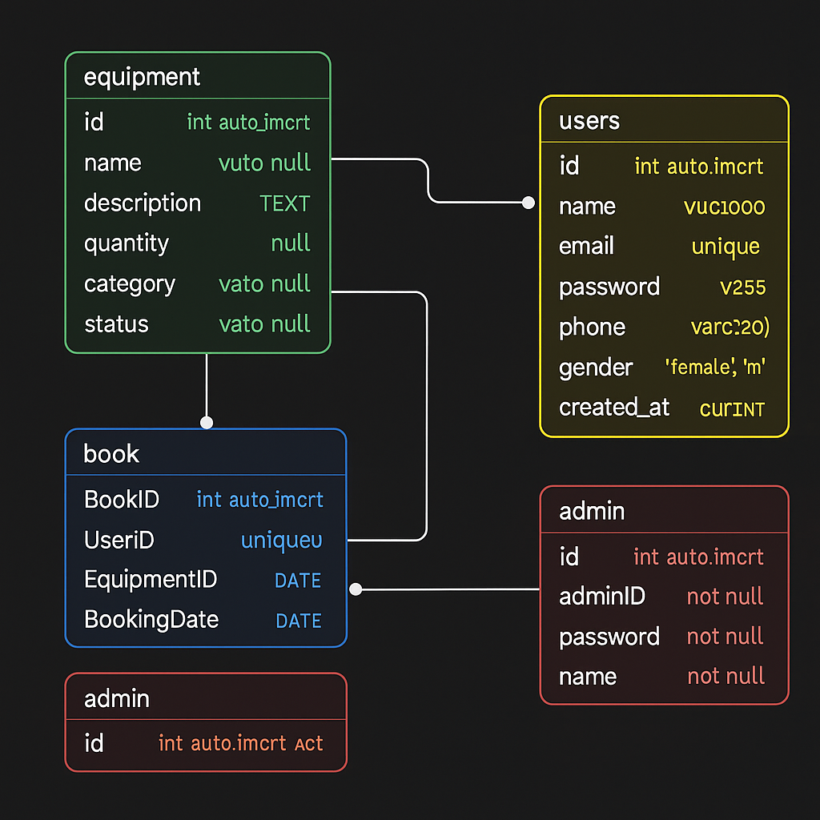
DATA MODEL

Slide 10

TOOLS USED
FRONTEND
Html , CSS , Bootstrap , JavaScript
BACKEND
Python , Flask , Mysql

